Slide 1
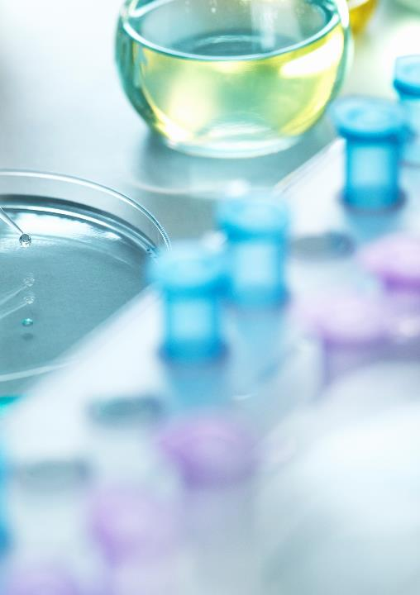

Chemistry-lab section: m
American international university-bangladesh
DIRECTED BY:
PRESENTED BY: GROUP-7
NAME | ID
SAYEDA TANJILA AHMED (APURBA) | ********

Slide 2

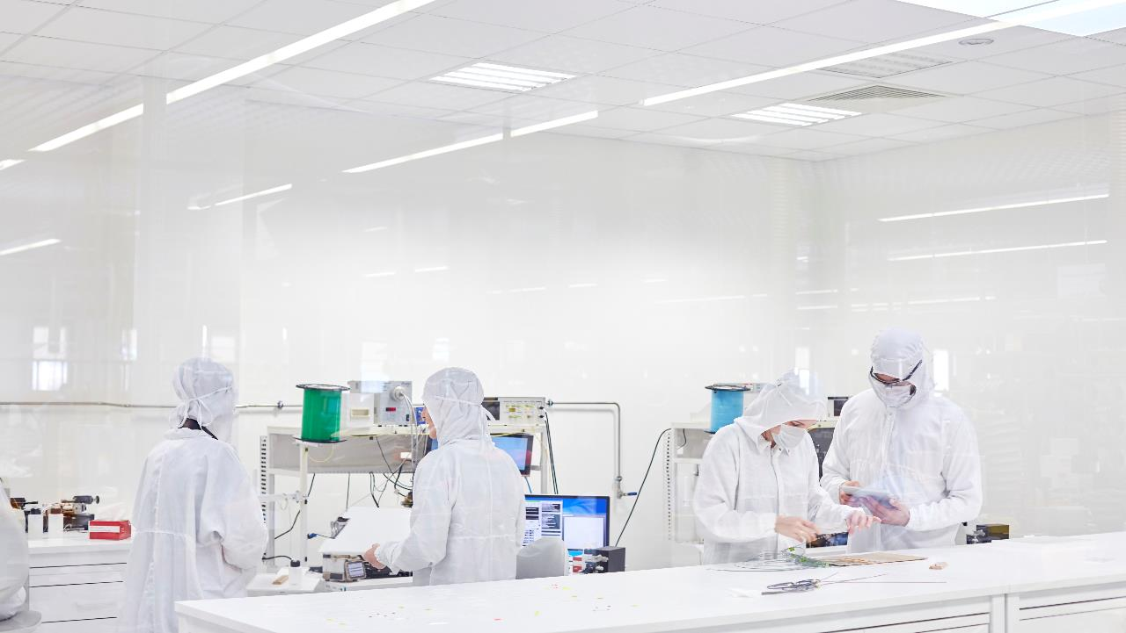
EXPERIMENT- 6
Estimation of copper (Cu) contained in a supplied solution of copper salt by iodometric method
INTRODUCTION
The amount of copper ions in a supplied solution of copper salt will be measured by iodometric oxidation-reduction titration. K₂Cr₂O₇ is a primary standard substance, an oxidizing agent and Na₂S₂O₃.5H₂O is a secondary standard substance, a reducing agent.
REACTION
The balanced reactions are as follows:
2CuSO₄ + 4KI = 2K₂SO₄ + 2CuI ↓ + I₂
2Na₂S₂O₃ + I₂ = Na₂S₄O₆ + 2NaI
Redox Half Reactions
For 1: (a) 2I⁻ _{(aq.)} → I_{2 (aq.)} + 2e (oxid. half reaction)
(b) 2Cu²⁺ _{(aq.)} + 2e → 2Cu⁺ _{(aq.)} (red. half reaction)
For 2: (a) 2S₂O₃²⁻_{(aq.)} → S₄O₆²⁻ + 2e (oxid. half reaction)
(b) I₂ _{(aq.)} + 2e → 2I⁻_{(aq.)} (red. half reaction)

Slide 3


APPARATUS
Burette (50mL),
pipette (10mL),
conical flask (250mL),
volumetric flask (100mL),
watch glass,
pipette filler,
dropper,
stand and clamp.

Slide 4

REQUIRED CHEMICALS
12% KI (Potassium iodide) solution,
Copper salt solution
NaHCO₃ (Sodium bicarbonate) solid,
6M NH₄OH (Ammonium hydroxide )
Conc. HCl (Hydrochloric acid),
Conc. CH₃COOH (Acetic acid)
Standard K₂Cr₂O₇ (Potassium dichromate) solution,
10% NH₄SCN (Ammonium thiocyanate) solution,
Na₂S₂O₃ (Sodium thiosulphate) solution,
Starch solution

Slide 5

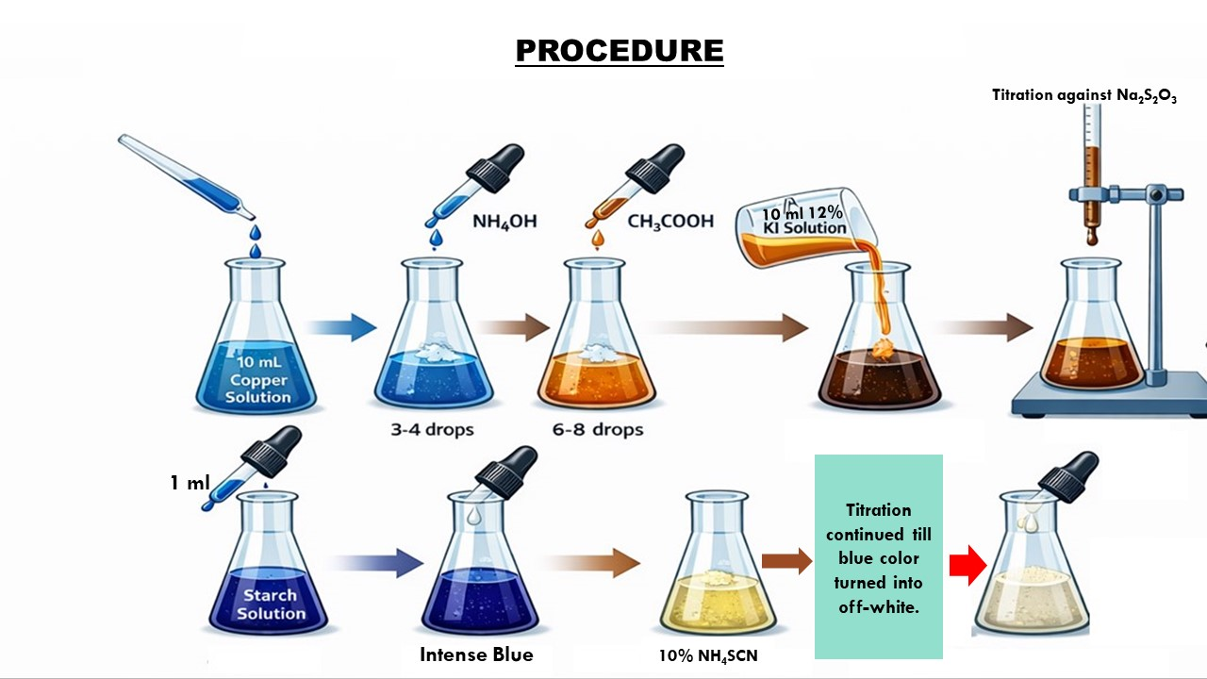
5
3
1
2
4
8
7
6
Repeated 3 times.
Figure: Estimation of copper (Cu) contained in a supplied solution of copper salt by iodometric method
Reference: (Modified version) created using ChatGPT (OpenAI,2025)

Slide 6
EXPERIMENTAL DATA:
Table-1: Standardization of supplied Na₂S₂O₃ solution against standard K₂Cr₂O₇ solution by
oxidation-reduction titration.
No. of reading | Vol. of K₂Cr₂O₇ (in mL) | Vol. of Na₂S₂O₃ (burette reading) (in mL) |  |  | Mean (in mL)
 |  | Initial | Final | Difference
1 | 10 | 0 | 10.9 | 10.9 | 10.3
2 | 10 | 10.9 | 20.6 | 9.7
Table-2: Determination of the amount of copper in a supplied solution of blue vitriol by
iodometric method.
No. of reading | Vol. of Copper salt solution (in mL) | Vol. of Na₂S₂O₃ (burette reading) (in mL) |  |  | Mean (in mL) (V)
 |  | Initial | Final | Difference
1 | 10 | 0 | 9.1 | 9.1 | 8.73
2 | 10 | 9.1 | 17.7 | 8.6
3 | 10 | 17.7 | 26.2 | 8.5

Slide 7
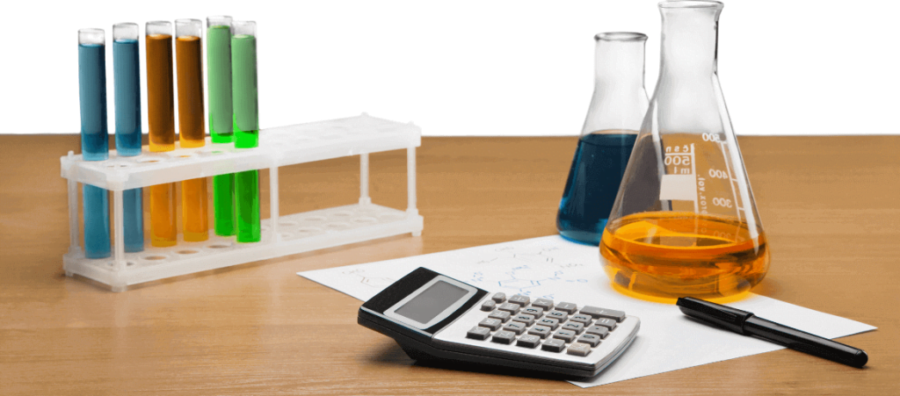
CALCULATIONS:
Strength of K₂Cr₂O₇ solution =
(N) =
N
Strength of supplied Na₂S₂O₃ solution (S): V_{thio} x N_{thio} = V_{dichromate} x N_{dichromate}
or, N_{thio} =
2 CuSO₄ ≡ I₂ ≡ 2 Na₂S₂O₃
1 ml 1N Na₂S₂O₃ ≡ 0.06354 gm of Cu²⁺
Amount of copper ions in 10 mL of copper salt solution = 0.06354 × V × S gm
= 0.06354 × 8.73× 0.099 gm
= 0.054 gm.
Amount of copper ions in 500 mL of copper salt solution = 0.06354 × V × S × 50 gm
= 0.06354 × 8.73× 0.099 × 50 gm
= 2.70 gm.
Observe value of Cu²⁺ (in 500mL solution) = 2.70 gm.
Known value of Cu²⁺ (in 500mL solution) = 2.543 gm.
N

Slide 8

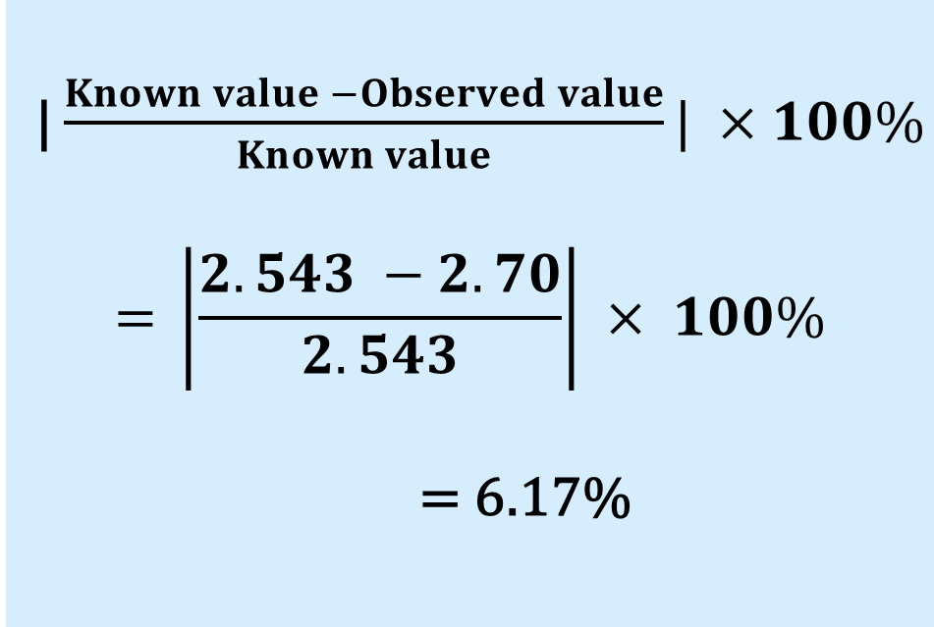
PERCENTAGE OF ERROR:
| $\frac{Known value −Observed value}{Known value}| ×100\%$
$$\text{= }\left|\frac{2.543 −2.70}{2.543}\right| × 100\%$$
= 6.17%
RESULTS:
Amount of copper ions in 500 mL of copper salt solution = 2.70 gm

Slide 9
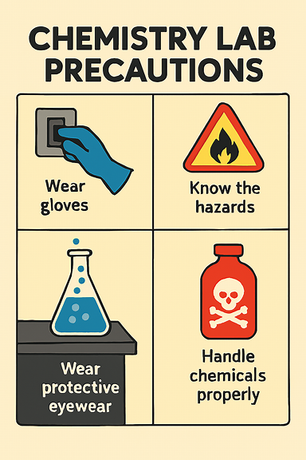
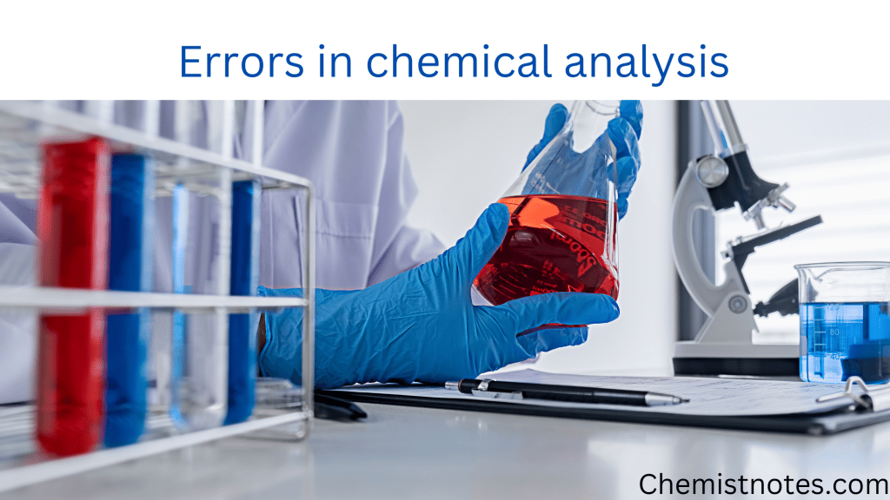
DISCUSSIONS
POSSIBLE ERRORS
In this experiment, the percentage of error obtained was 6.17%, which may be occurred due to lack of precautions or possible errors. The precautions taken for this experiment and possible errors that could have been occurred are as follows:-

Slide 10

PRECAUTIONS TAKEN:
The burette was checked for air bubbles in the nozzle before starting the titration to ensure correct volume delivery.
The flask was gently swirled continuously during titration to ensure uniform mixing of reactants.
All glassware such as burette, pipette, and conical flask were properly cleaned with distilled water before use to avoid wrong volume.
The sodium thiosulphate solution was protected from air and light as it can decompose on exposure, which may affect its strength.
The titration was carried out slowly near the end point to ensure accurate detection of the color change.

Slide 11


POSSIBLE ERRORS:
Impurities present in the supplied copper salt solution
may interfere with the liberation of iodine.
Inaccurate standardization of sodium thiosulphate
solution directly affects the calculated copper content.
Parallax error may occur while reading the burette, which can cause slight variation in volume measurement.
Incomplete mixing of the solution during titration may result in uneven reaction and inaccurate end point detection.
Excess addition of ammonium hydroxide or acetic acid may disturb the reaction conditions, affecting the final result.

Slide 12
ON BEHALF OF
GROUP-7
American international university-bangladesh
THANK YOU

